Slide 2
PIM-PDO Incident Management
Generating My Bundle Report –MSE 511

Slide 3
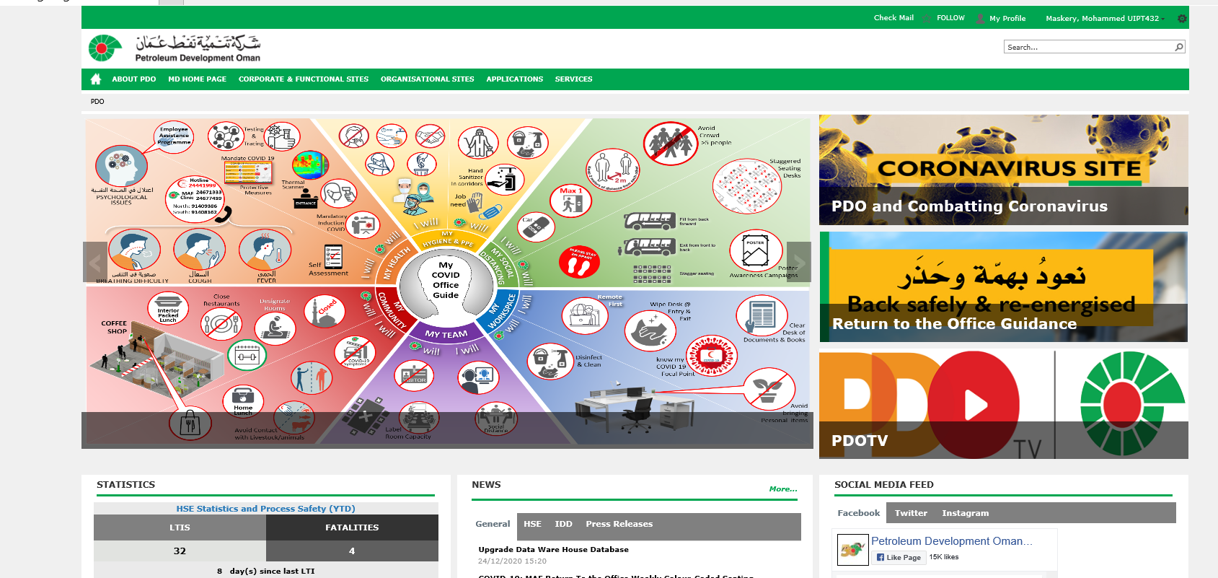
1)
First go to the PDO intranet home page
2)
Scroll down and search
PIM-PDO incident Management in Applications.
3)
Click on the PIM-PDO incident Management

Slide 4
Once you land on the PIM homepage, you will see on top right Home, Main Menu, setting & help
1) select Main Menu icon
2) select Report

Slide 5
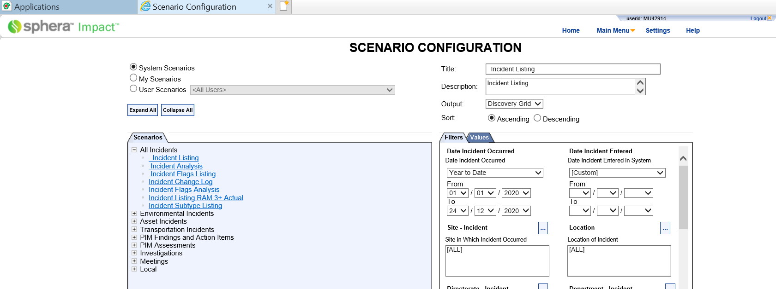
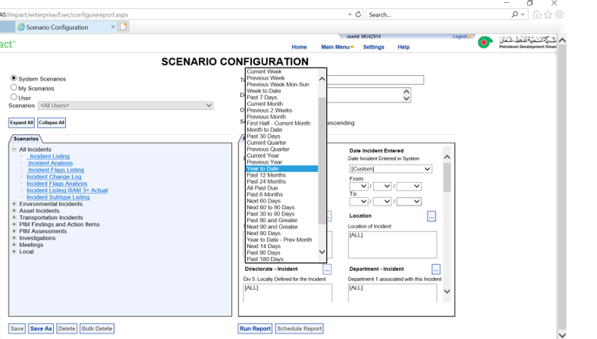
3) Under System Scenarios Select All Incident then incident Listing
4) Select date incident occurred

Slide 6
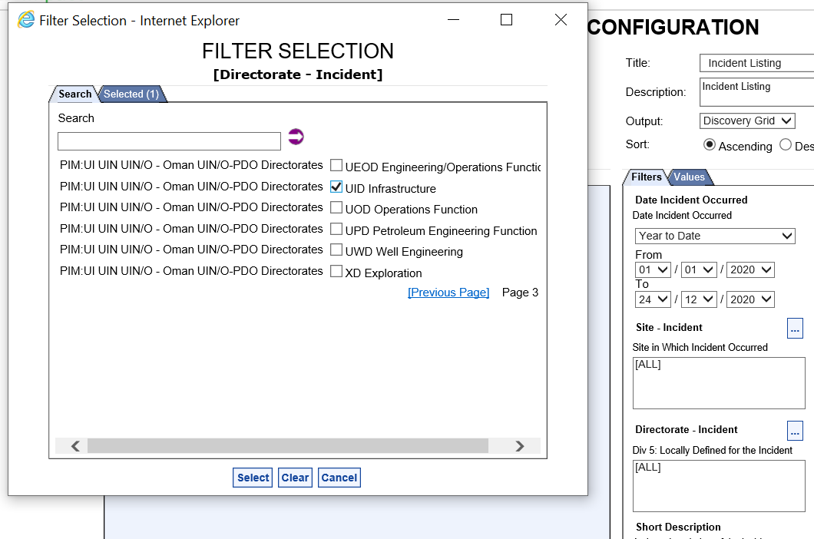
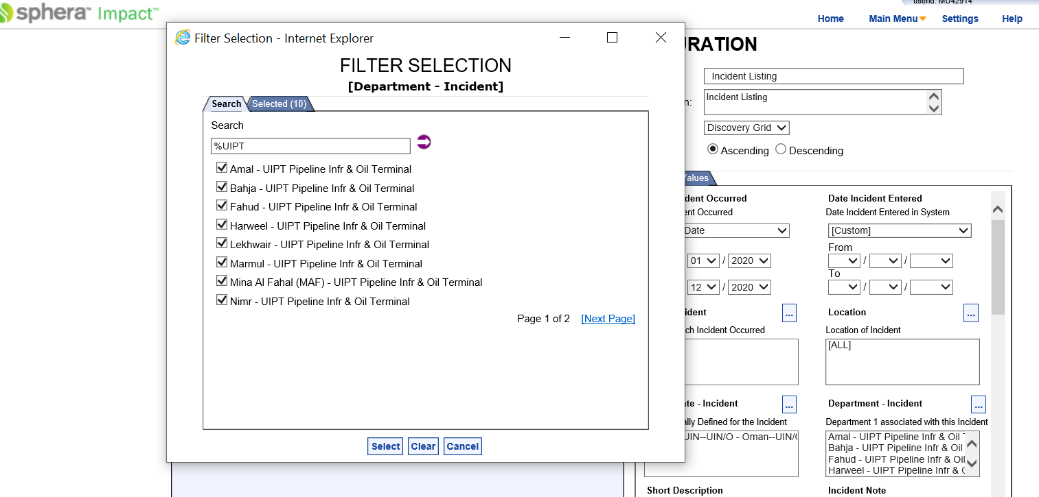
5) Search for the required Directorate-(scroll in next page to find the required Directorate) example Select UID then press on select icon
7) Then Select required Department (if Required but not a must as long you have selected your directorate) example UIPT for faster search use % (%UIPT press the arrow ) then tick on all under UIPT in 2 pages then press on select icon

Slide 7
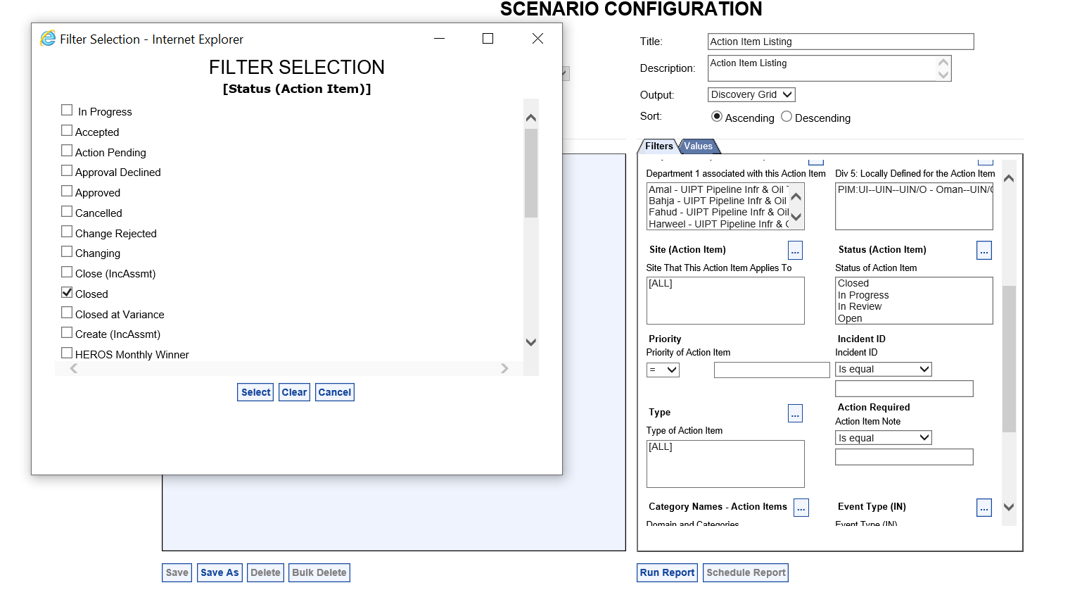
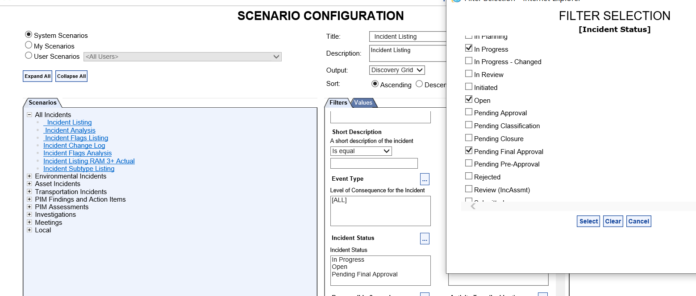
8) Select the required incident status
9) Then press on Select icon

Slide 8
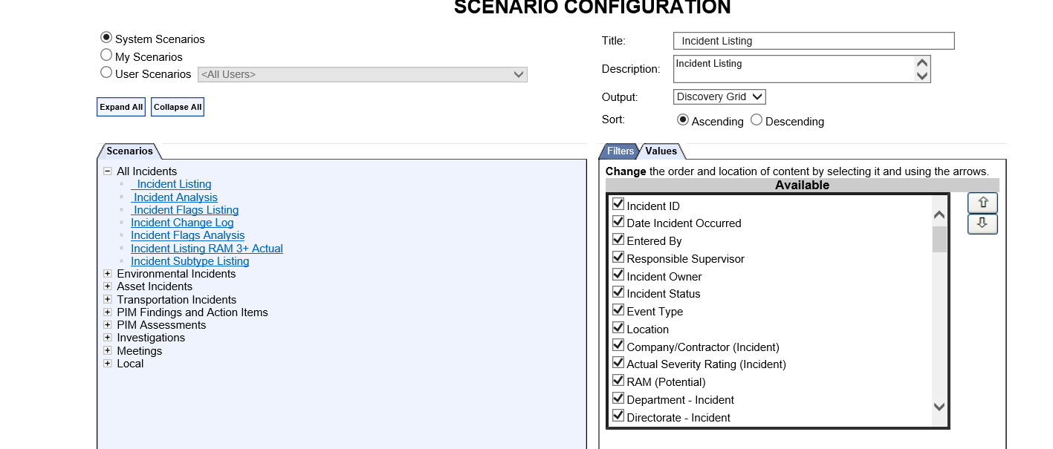
10) Select the required Values
11) The selected values can be moved by highlighting on the values and then use the arrows to move up and down them as shown in slide next slid-8
(This arrangement will appear in the excel sheet as selected when run the report)

Slide 9
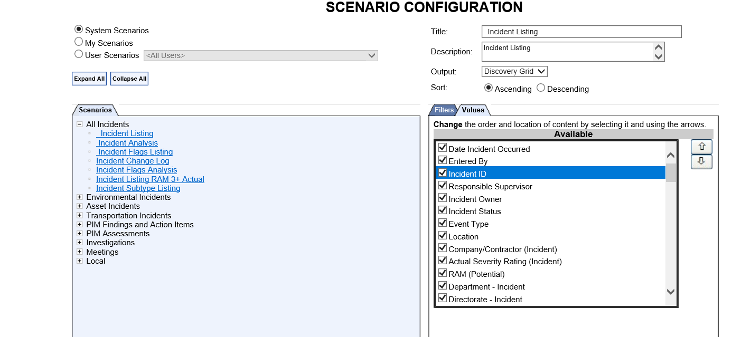
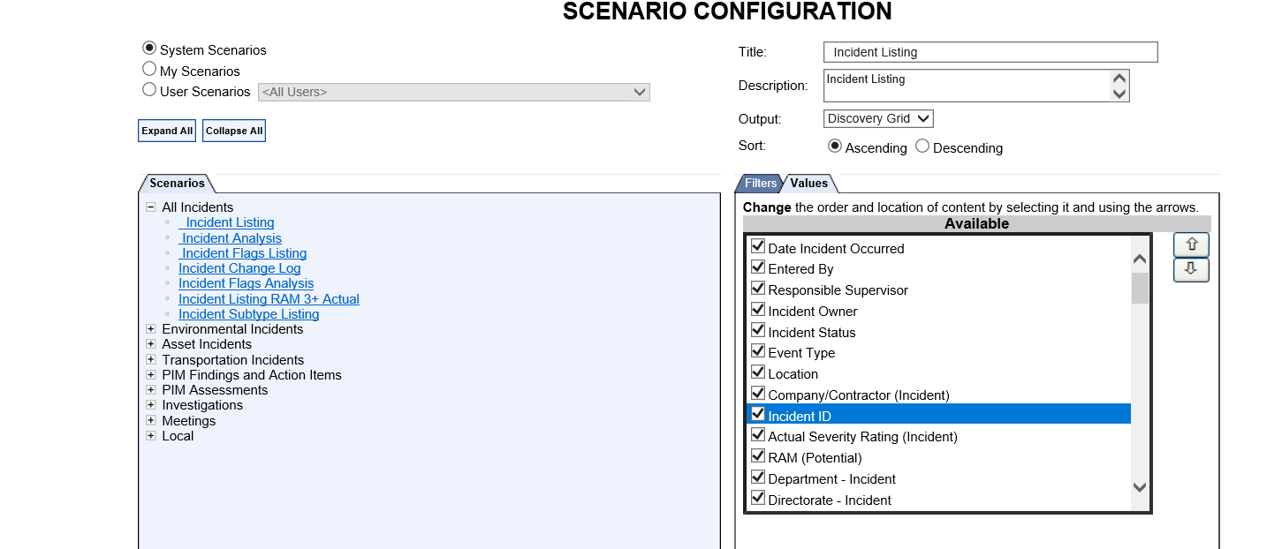
12) Moving the Values Up & Down

Slide 10
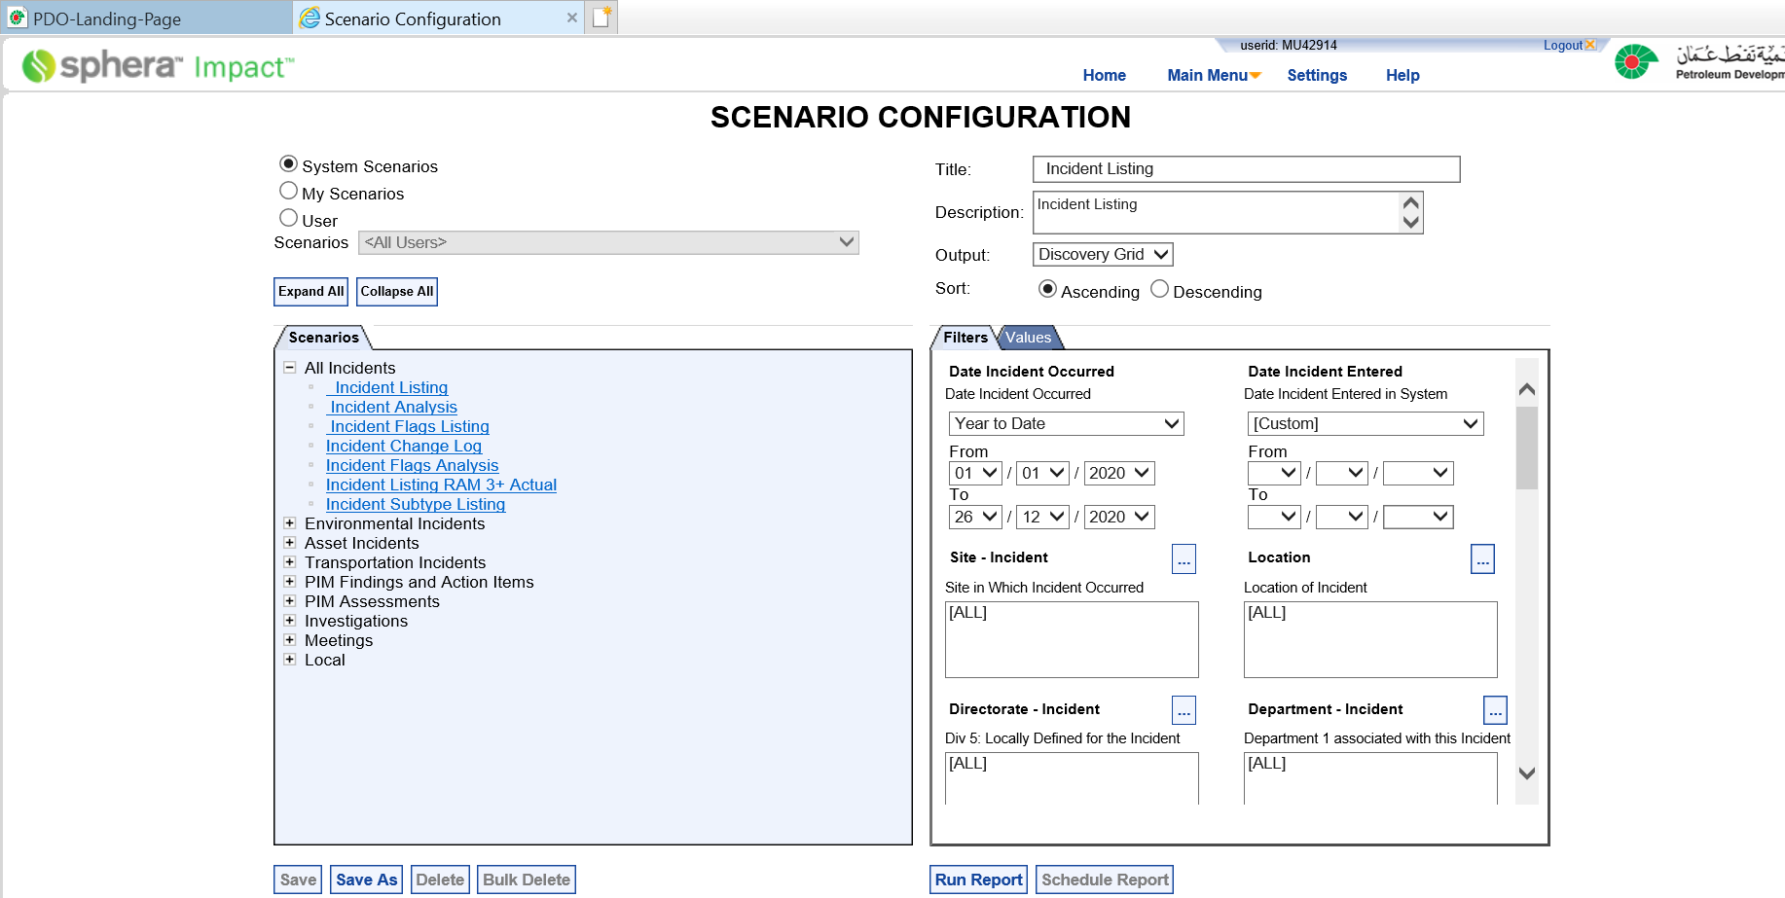
13) Once the above 12 steps completed select Save as then type the title as shown in the next slid

Slide 11
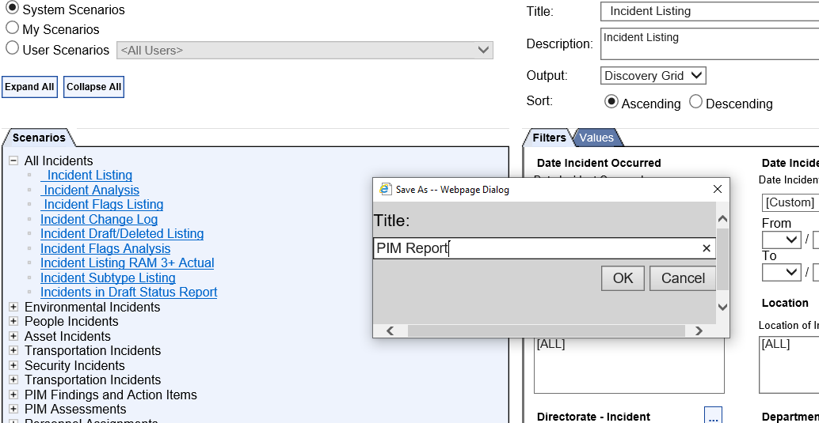
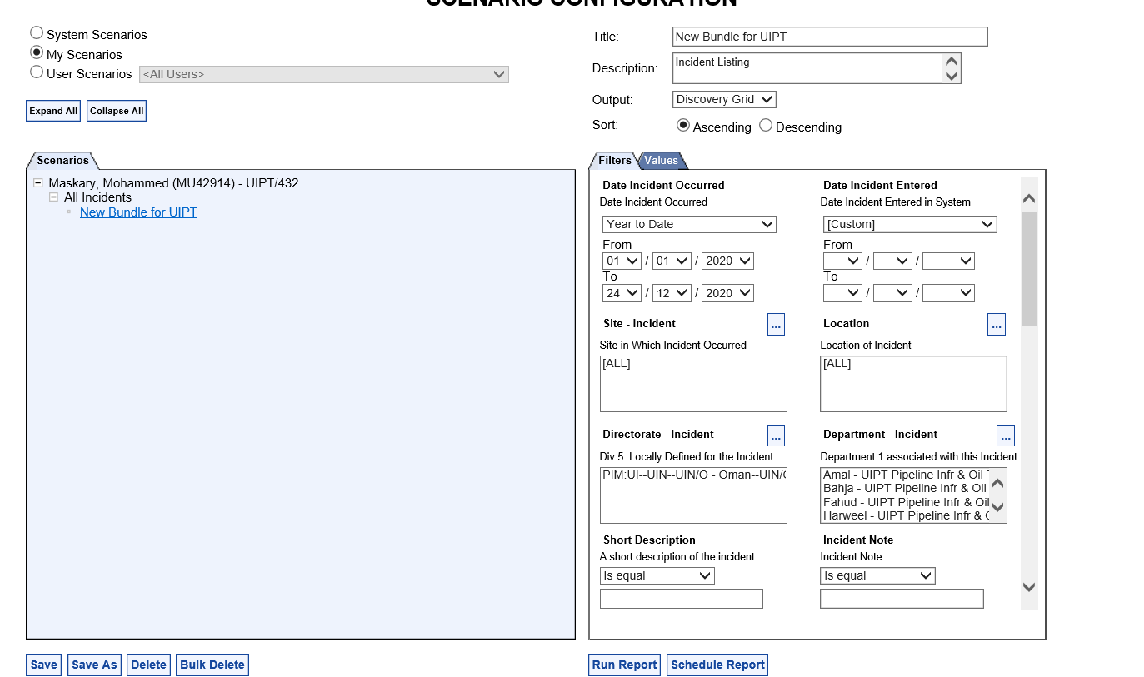
14) Type the Title then press Ok
15) The new Title will appear on title box in my scenario

Slide 12
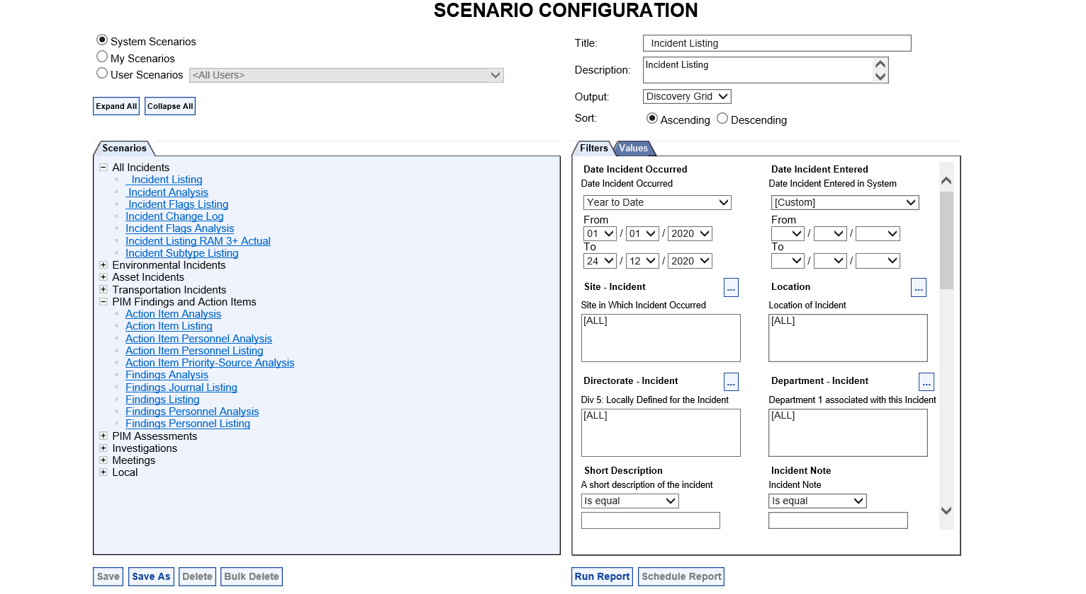
16) Then go back or go to report (PIM home page) and then from Main Menu select Report Again than select action item listing
17) Select PIM finding and action Items and then select action item listing
18) Repeat the same steps from 4 to 10 (directorate, department , incident status & values)to set PIM finding action Items and then select action item listing once you completed it will show both titles as shown in slid 12 the

Slide 13
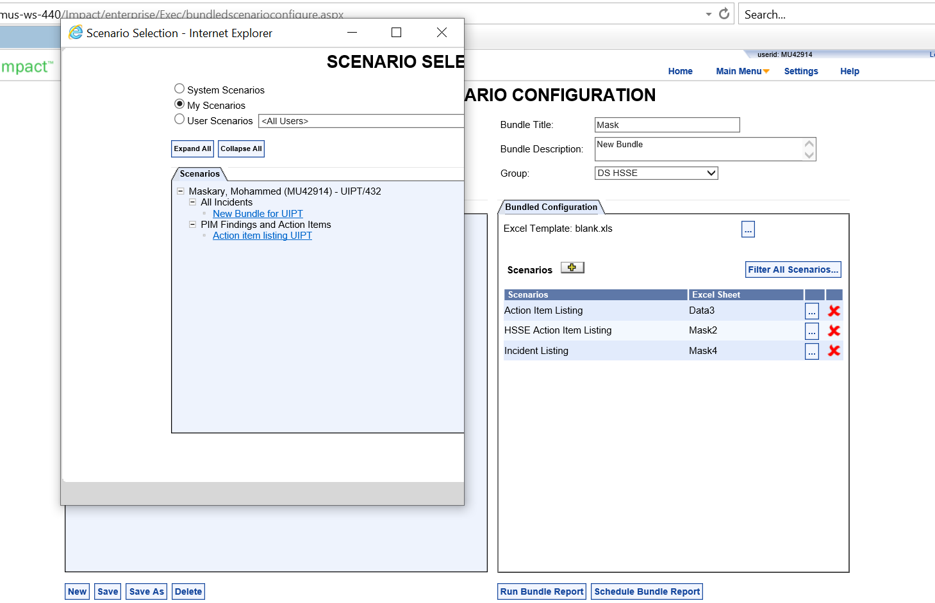
20) Both selected names (incident listing & action item listing will appear in my scenario
21) To set my own Bundle – select report Bundle

Slide 14
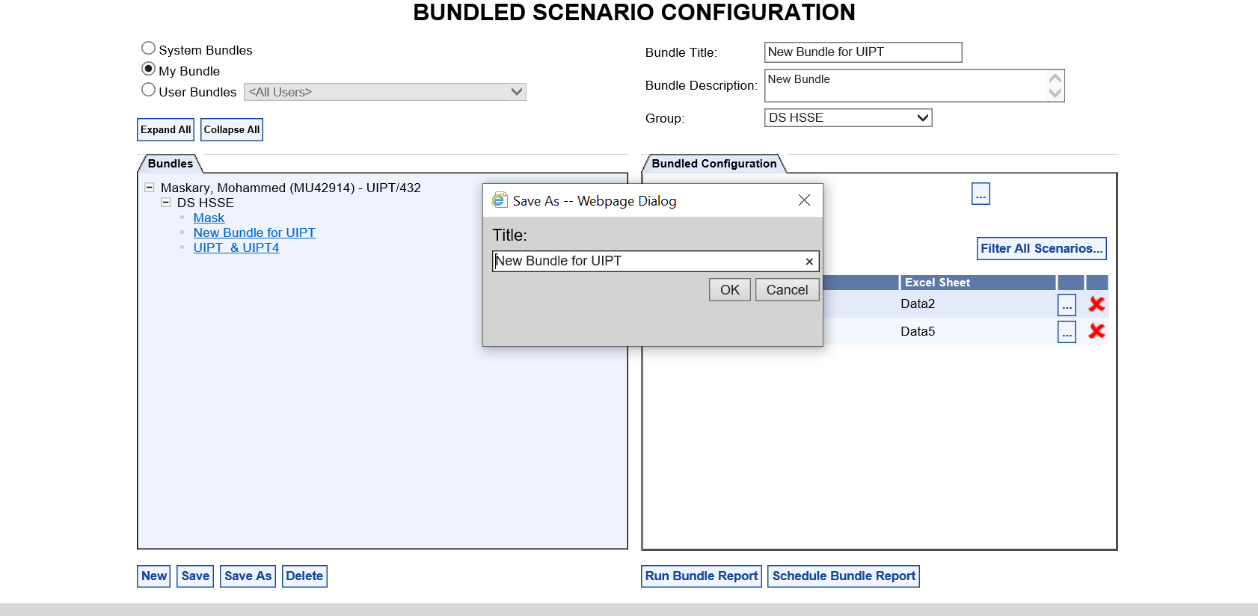
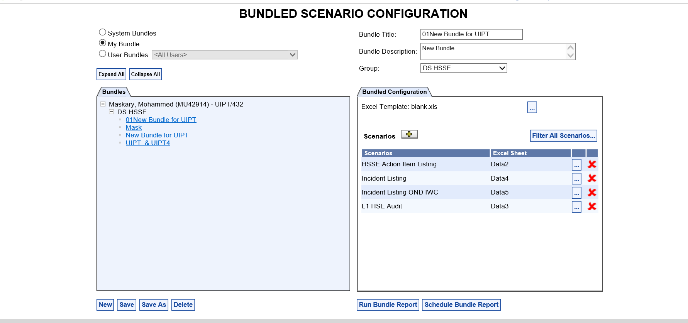
22) Select save as and then add your title then press OK (the new title will appear as a bundle title
22b)Bundle title
23) Select the new bundle for UIPT and go to seniors as shown in the next slid
22a)Save as
24) Remove all the Scenarios by clicking the X and then click on scenario add button.

Slide 15
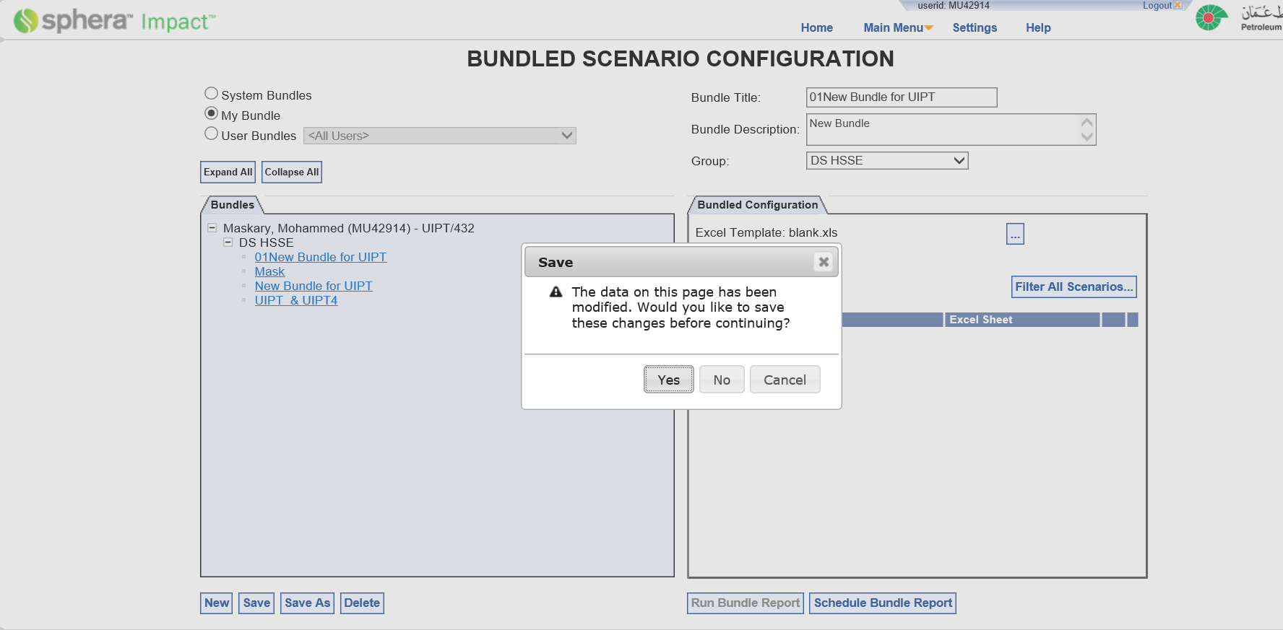
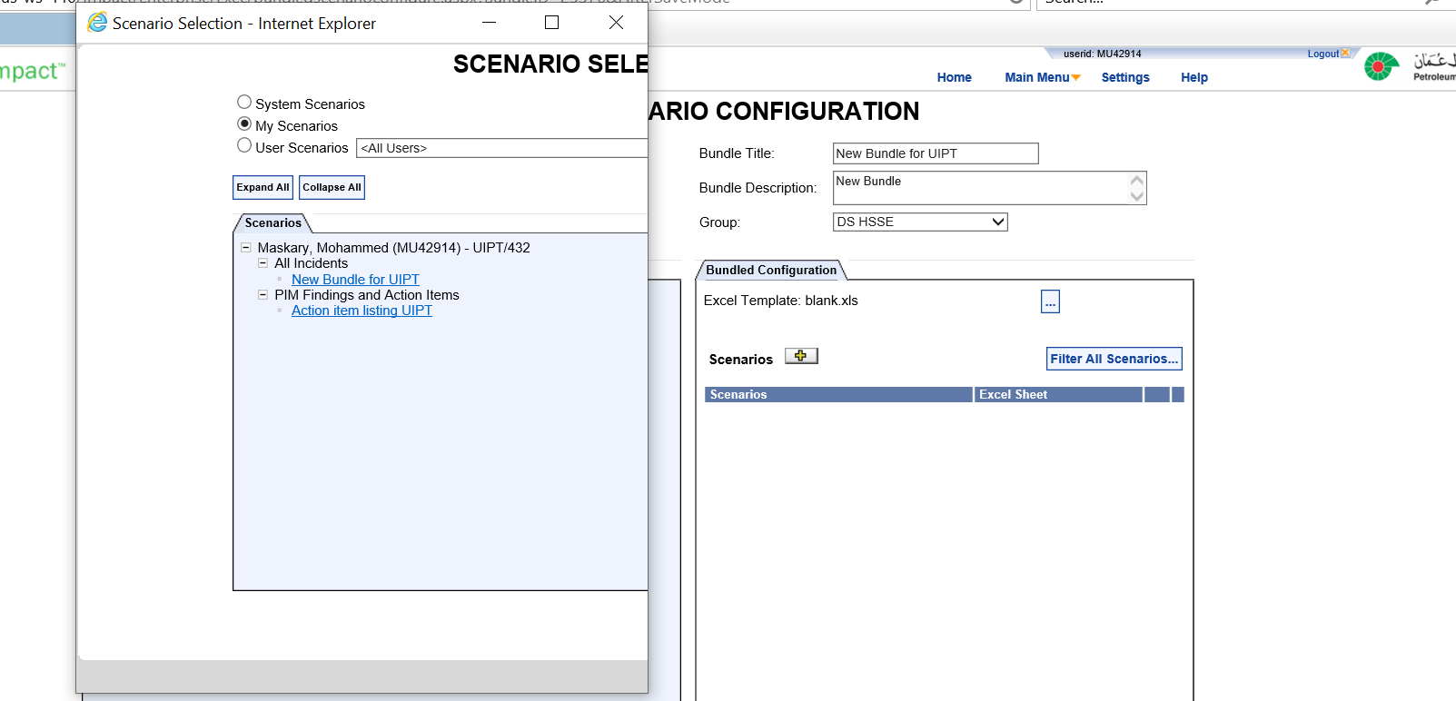
25) To save any modification the below box will appear –press Yes
27) One by one click on New bundle for UIPT and then go back and click on Click on action items UIPT- both will appear on scenario as shown in next slid
26) Click on senior

Slide 16
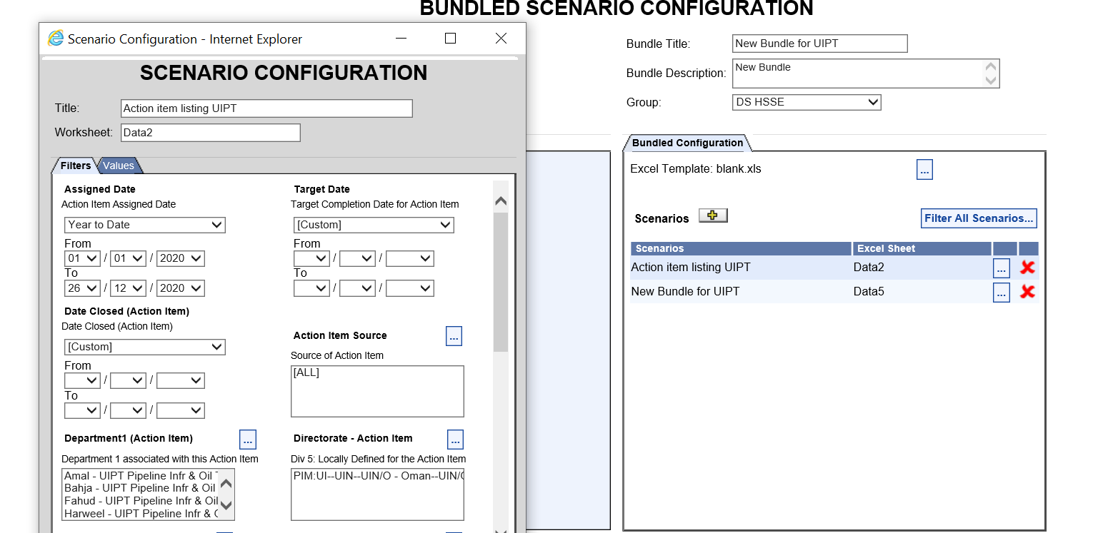
work sheet title
28) Your both scenarios will appear in my Bundle
29) The scenario work sheet title can be changed by clicking in the box and also the filtration of data can be done from same (3 dots) option button.

Slide 17
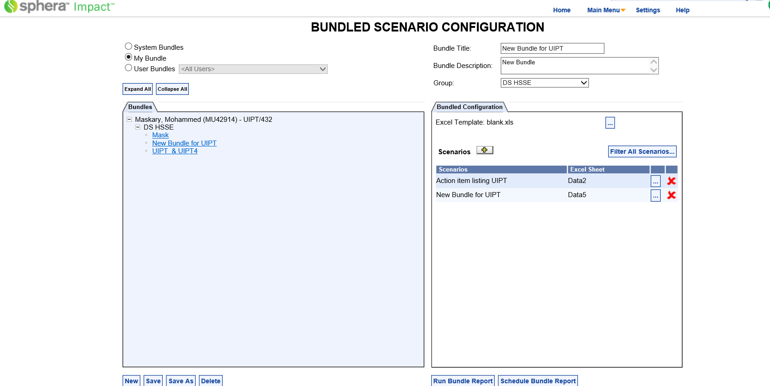
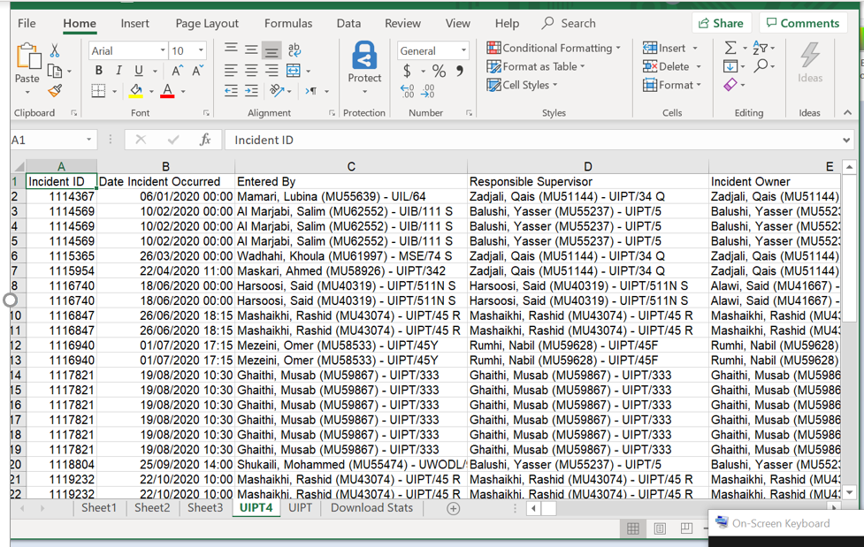
32) to automatically receive the report from the system click on schedule Bundle report on (if you have more than on task required task) – see the next slid to set it –if required
30) Click on run bundle report to run it once and test it.
31) Click on run bundle report- sort & filter as required (excel sheet)

Slide 18
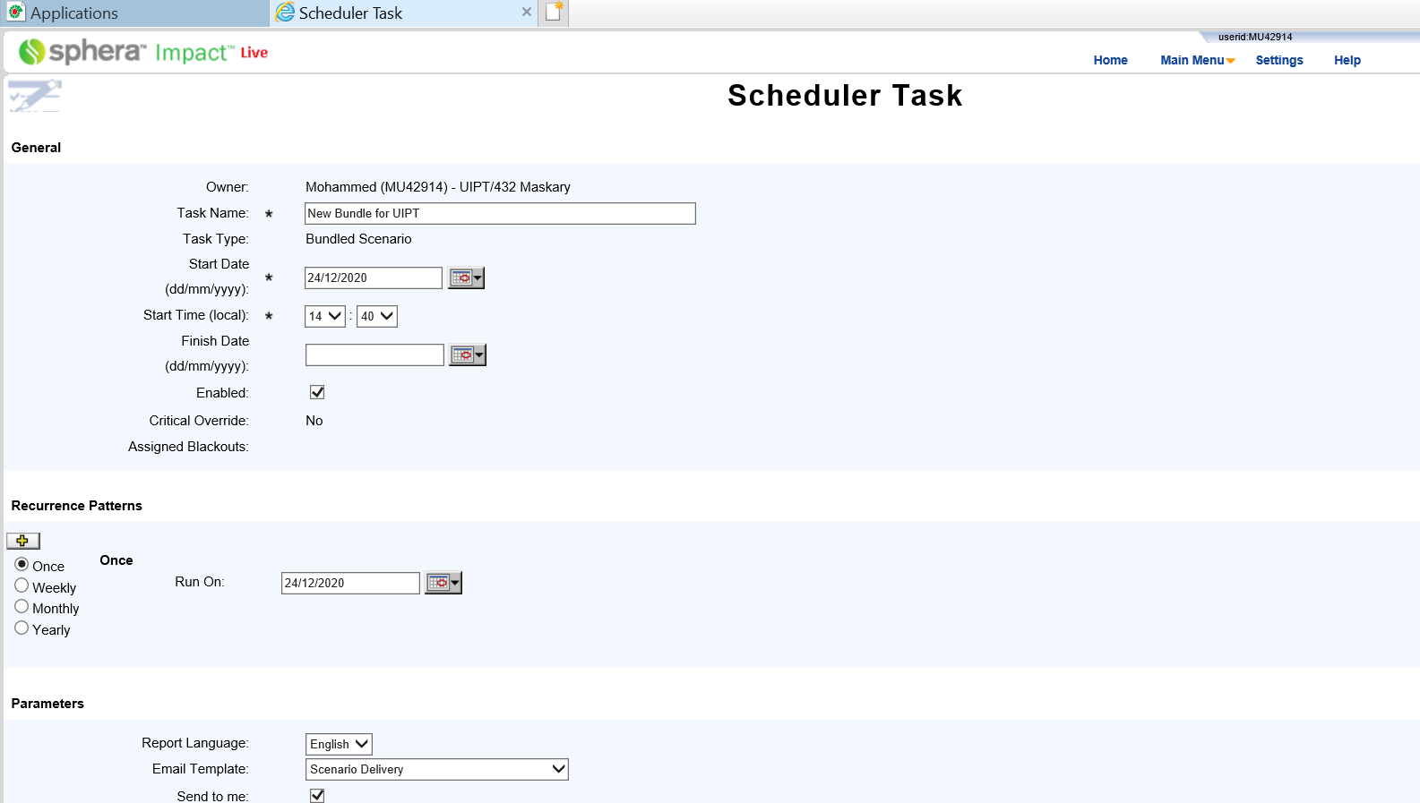
33) Select date , start time & finish time ( preferred to select the time between 2am to 3am to avoid Overloading the system during Working hours)
34) Recurrence Patterns ( to select the date you wish to receive the report on… i.e. daily or weekly or monthly)
35) Select Receptions if required (this is if you want other users to receive the same bundle as well)
For any further support MSE-511(HSE Date & System Analyst ) can be contacted

